Slide 1
Introduction to Python
Edward Wang, Ph.D.

Slide 2
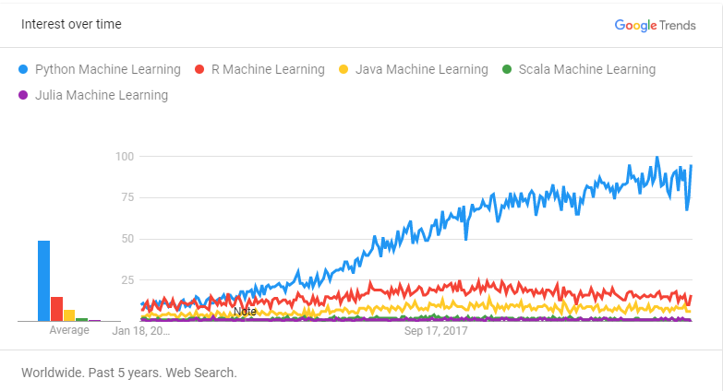
Why Python
Easy to use
Multiple libraries and frameworks
Has community and corporate support
Portable and Extensible

Slide 3
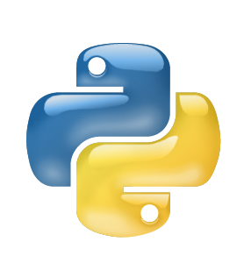

Installation of Python
Recommended: Mini Conda + Necessary Library
Installation: https://docs.conda.io/en/latest/miniconda.html
Python Version: Python 3.7
Conda Cheat Sheet: https://docs.conda.io/projects/conda/en/4.6.0/_downloads/52a95608c49671267e40c689e0bc00ca/conda-cheatsheet.pdf
Python Execution Tool: Jupyter Notebook
Notes:
As a server-client application, the Jupyter Notebook App allows you to edit and run your notebooks via a web browser. The application can be executed on a PC without Internet access, or it can be installed on a remote server, where you can access it through the Internet.
Its two main components are the kernels and a dashboard. A kernel is a program that runs and introspects the user’s code. The Jupyter Notebook App has a kernel for Python code, but there are also kernels available for other programming languages. The dashboard of the application not only shows you the notebook documents that you have made and can reopen but can also be used to manage the kernels: you can which ones are running and shut them down if necessary.

Slide 4
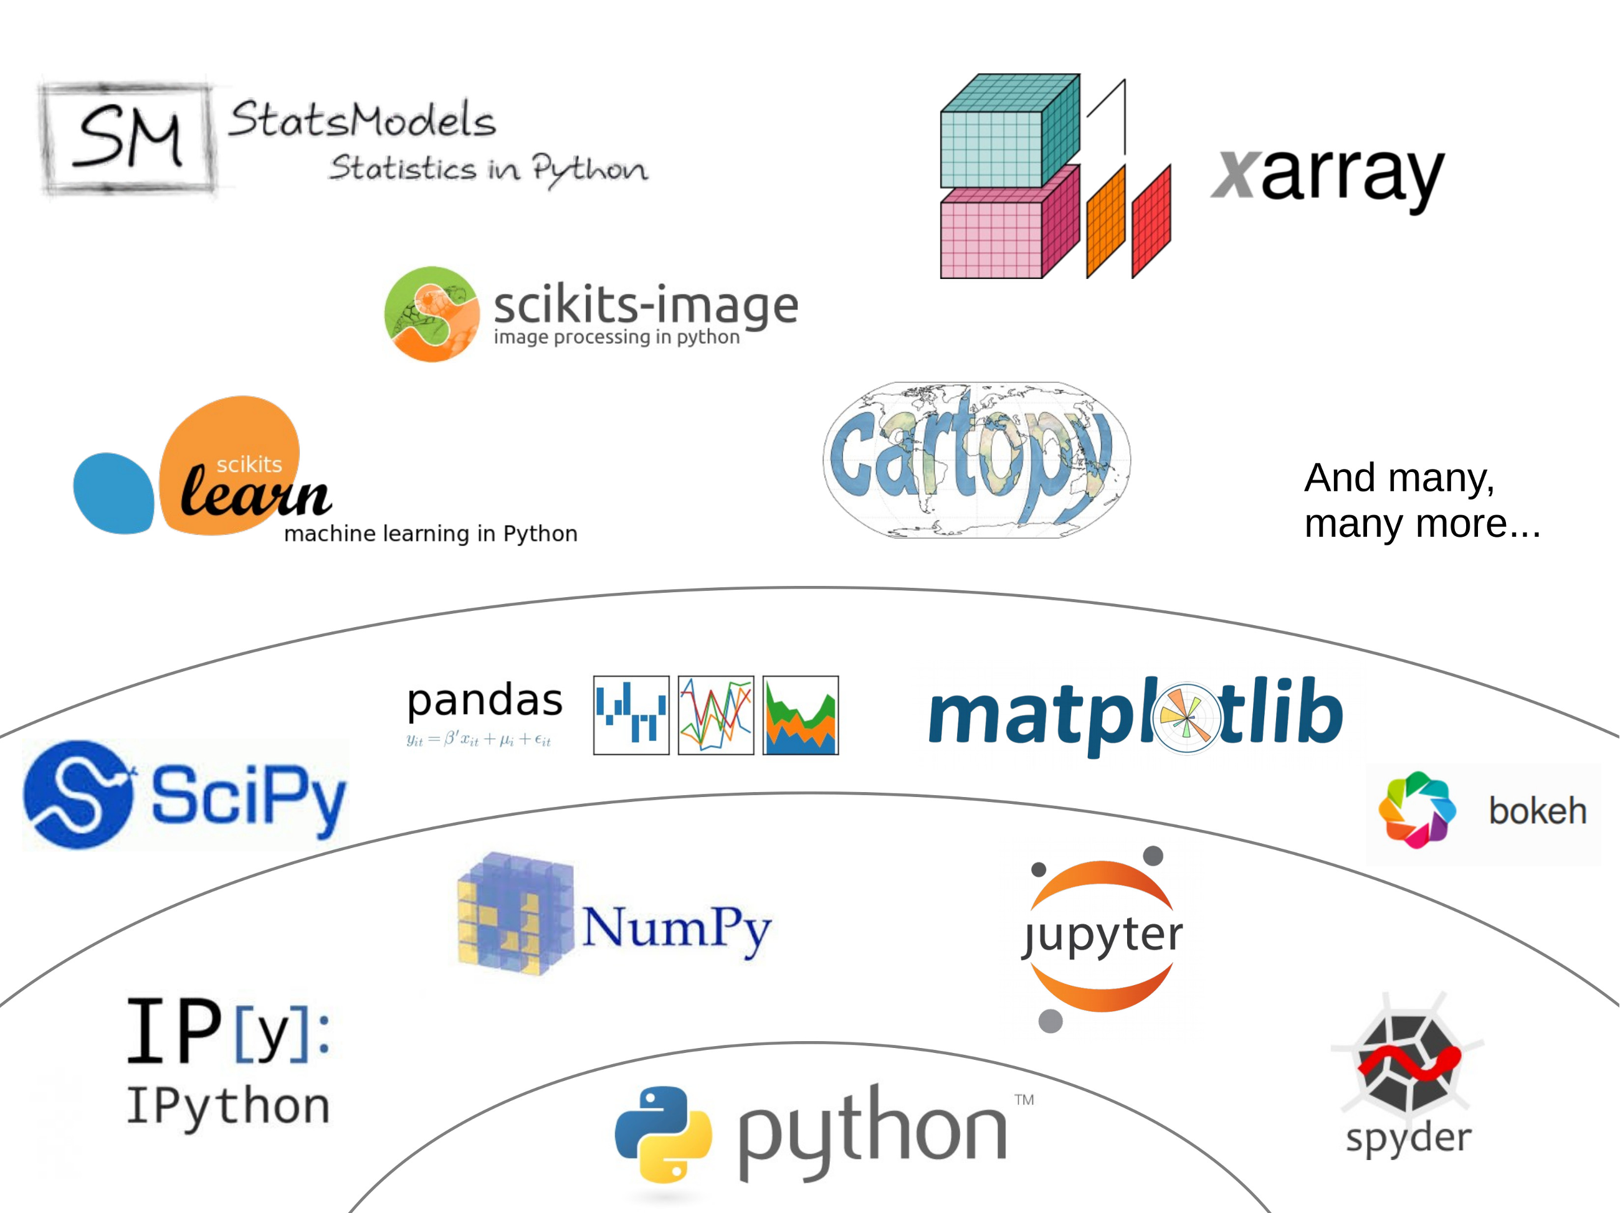
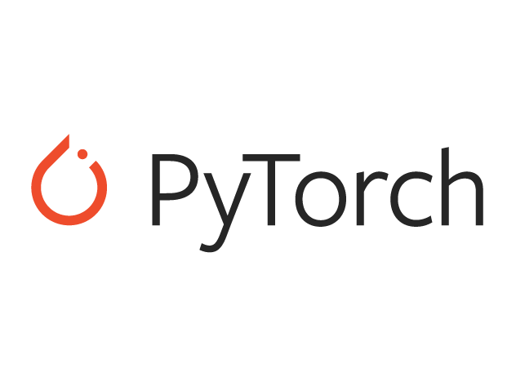
Python Modules

Slide 5
Numpy
Numpy provides fast precompiled functions for numerical routines, which involves large multidimensional arrays and matrices
NumPy allows apply standard mathematical operations on an entire data set without having to write loops
Basic Numpy Operations: array creation, indexing, operation, broadcasting, reshape
More operations: https://docs.scipy.org/doc/numpy/reference/

Slide 6
SciPy
SciPy builds on Numpy, and provides a large number of functions that operate on Numpy arrays and are useful for different types of scientific and engineering applications
SciPy operations: File I/O, linear algebra, signal processing (Fourier transforms), image processing, sparse matrix, statistics
Documentation: https://docs.scipy.org/doc/scipy/reference/index.html

Slide 7
Pandas
Pandas contains high-level data structures (similar to Excel) and tools designed for fast and easy data analysis operations. Pandas is built on NumPy and makes it easy to use in NumPy-centric applications, such as data str
Convert a Python’s list, dictionary or Numpy array to a Pandas data frame
Open a local file using Pandas, usually a CSV file, but could also be a delimited text file (like TSV), Excel, etc.
Documentation: https://pandas.pydata.org/pandas-docs/stable/

Slide 8
Matplotlib
Powerful plotting library
Its matplotlib.pyplot module provides a plotting system similar to that of MATLAB
Commonly used functions: line plot, scatter plot, bar plot, images
Documentation: https://matplotlib.org/api/pyplot_api.html#

Slide 9
Torch
Will be covered when talk about neural networks!

